Slide 1

Tinkering Boot Camp
Week 2 | Session 1

Slide 2
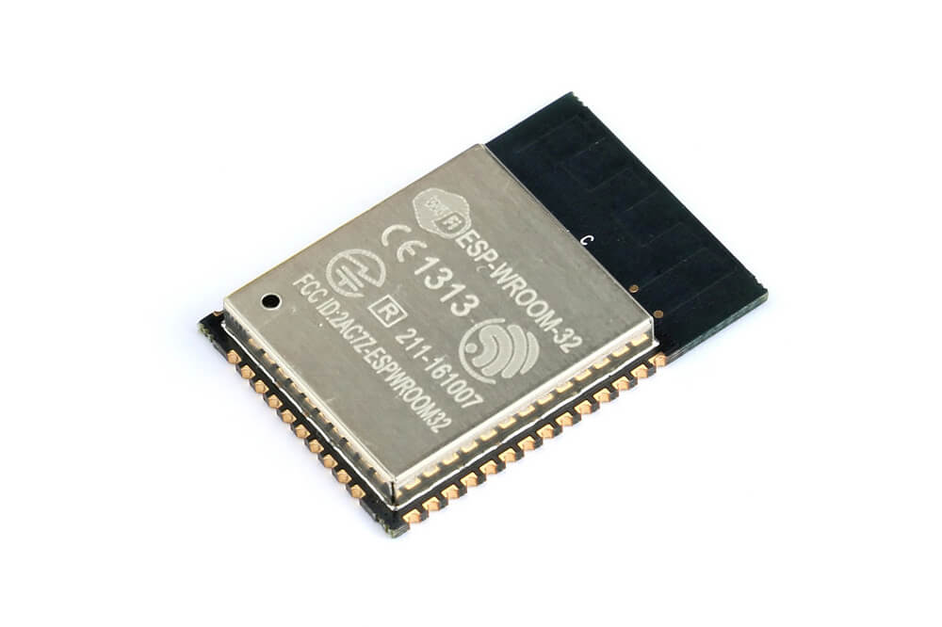

ESP-WROOM-32
Made by Espressif Systems

Slide 3
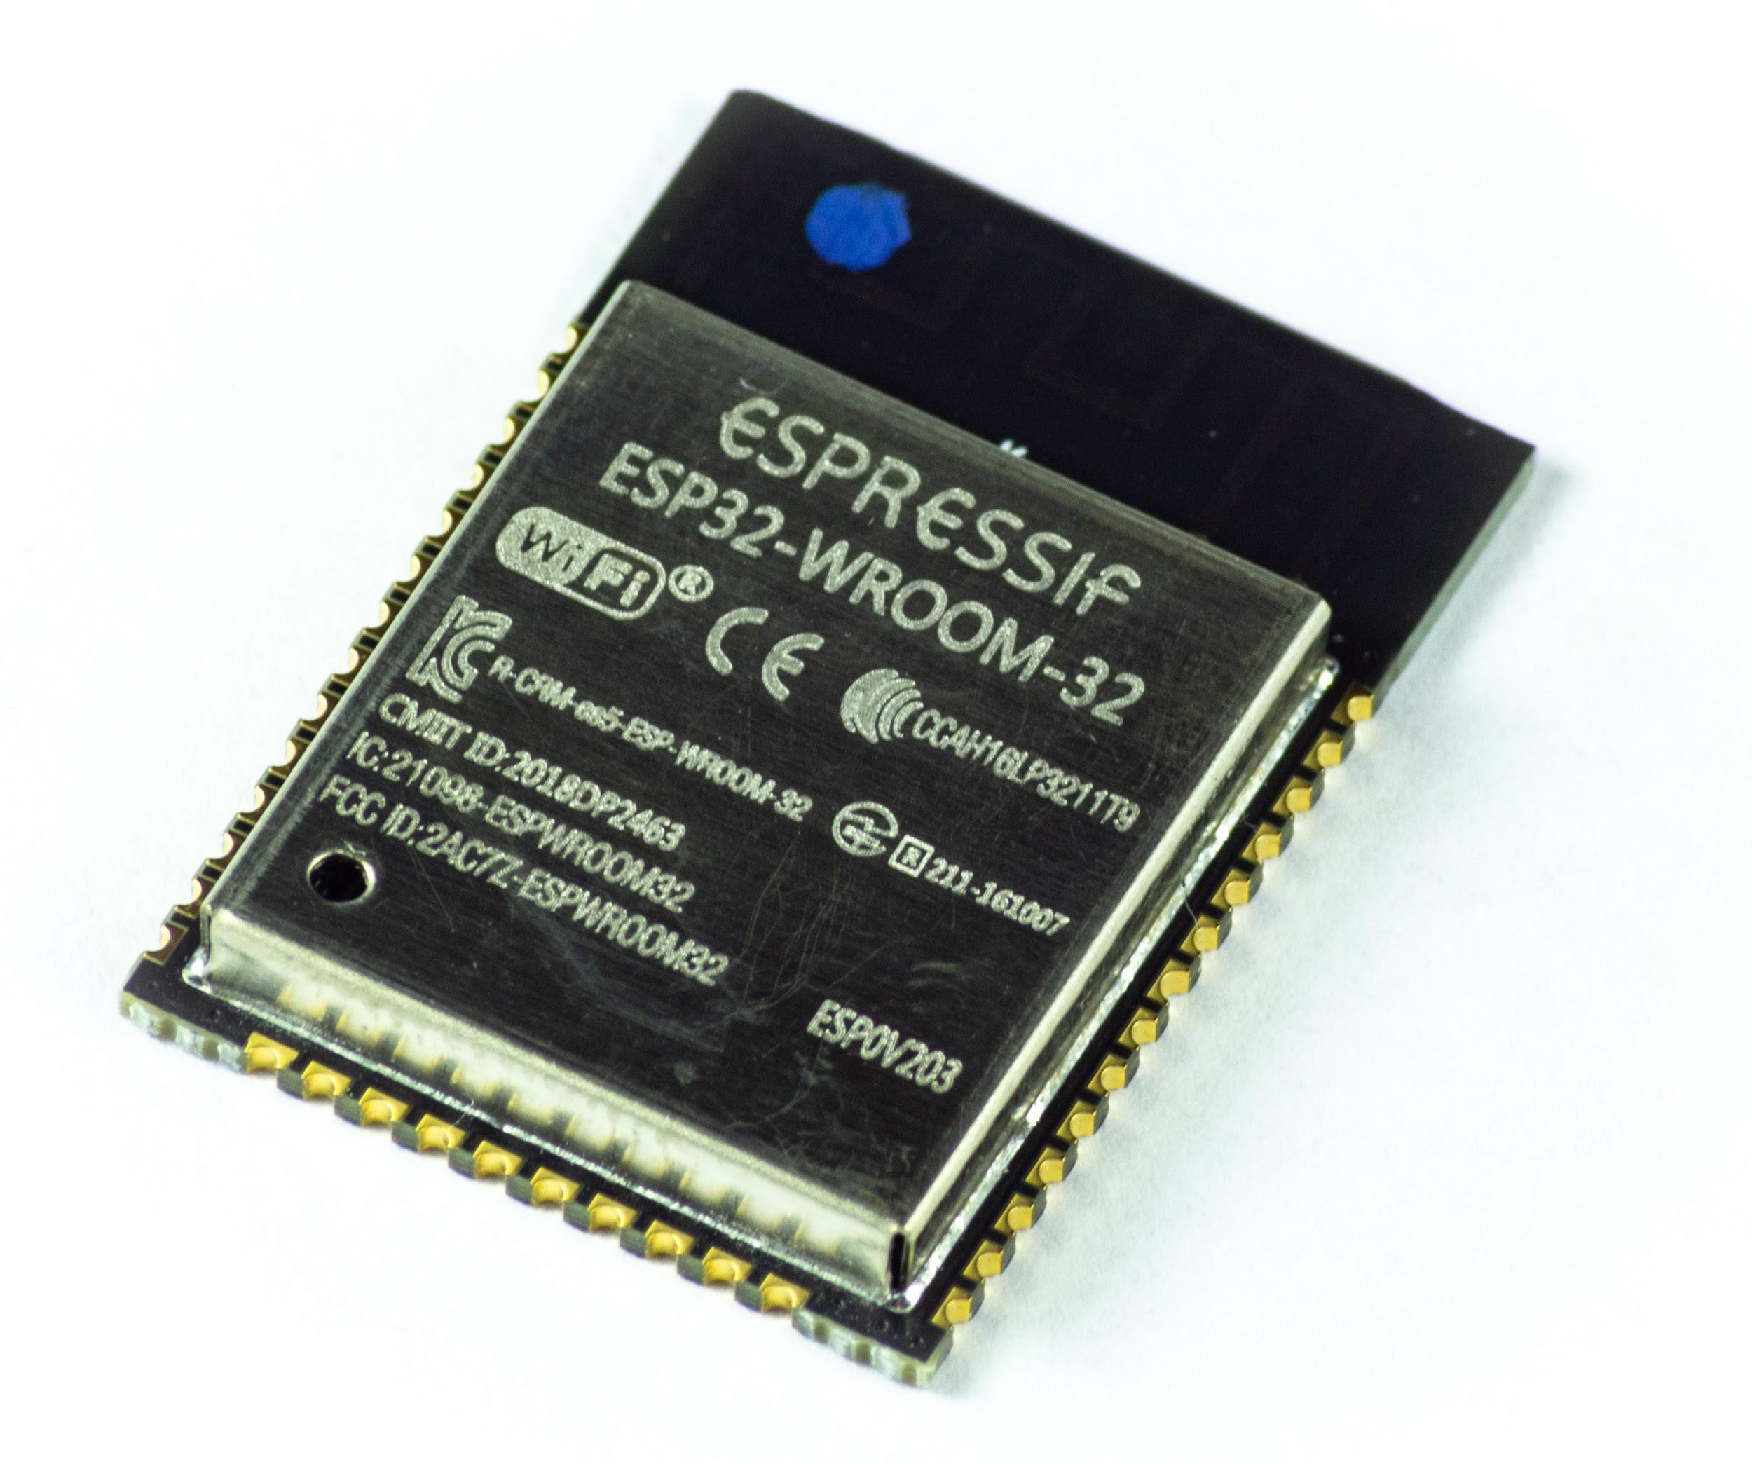
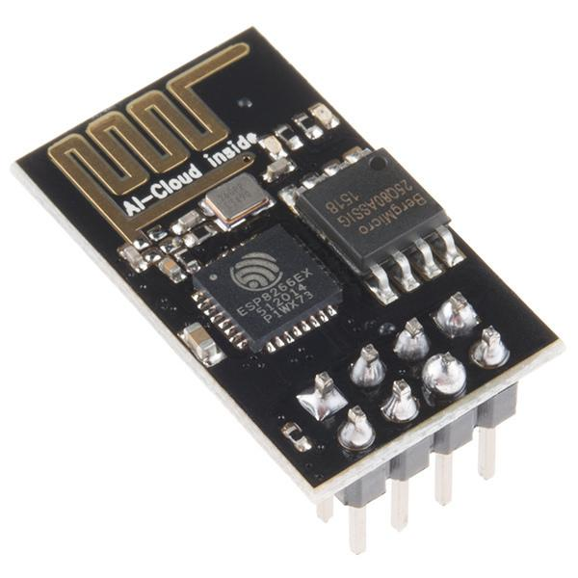
A brief overview of ESP32
Predecessor
Successor
ESP8266
ESP-WROOM-32

Slide 4
A brief overview of ESP32
Salient features:
No. of Cores | 2 (Dual)
WiFi | 2.4 GHz upto 150 Mbps
Bluetooth | BLE and legacy Bluetooth
Architecture | 32 bits
Clock Frequency | 240 MHz
RAM | 512 kB
ESP-WROOM-32

Slide 5
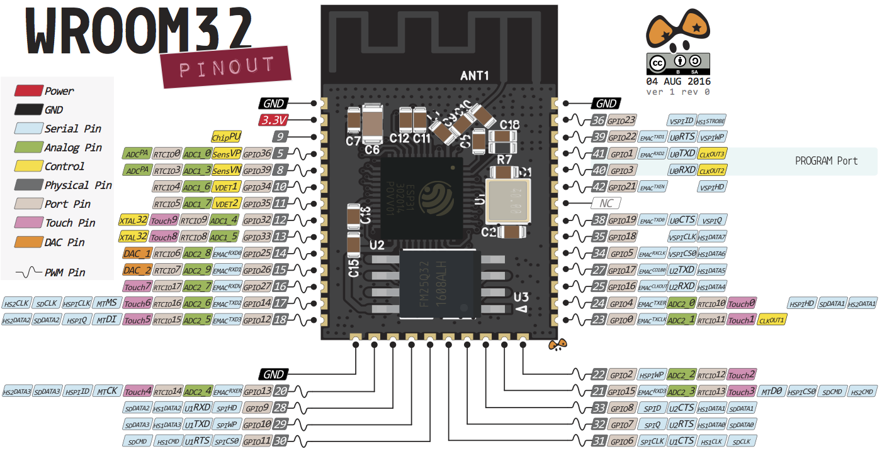
A brief overview of ESP32
ESP-WROOM-32

Slide 6
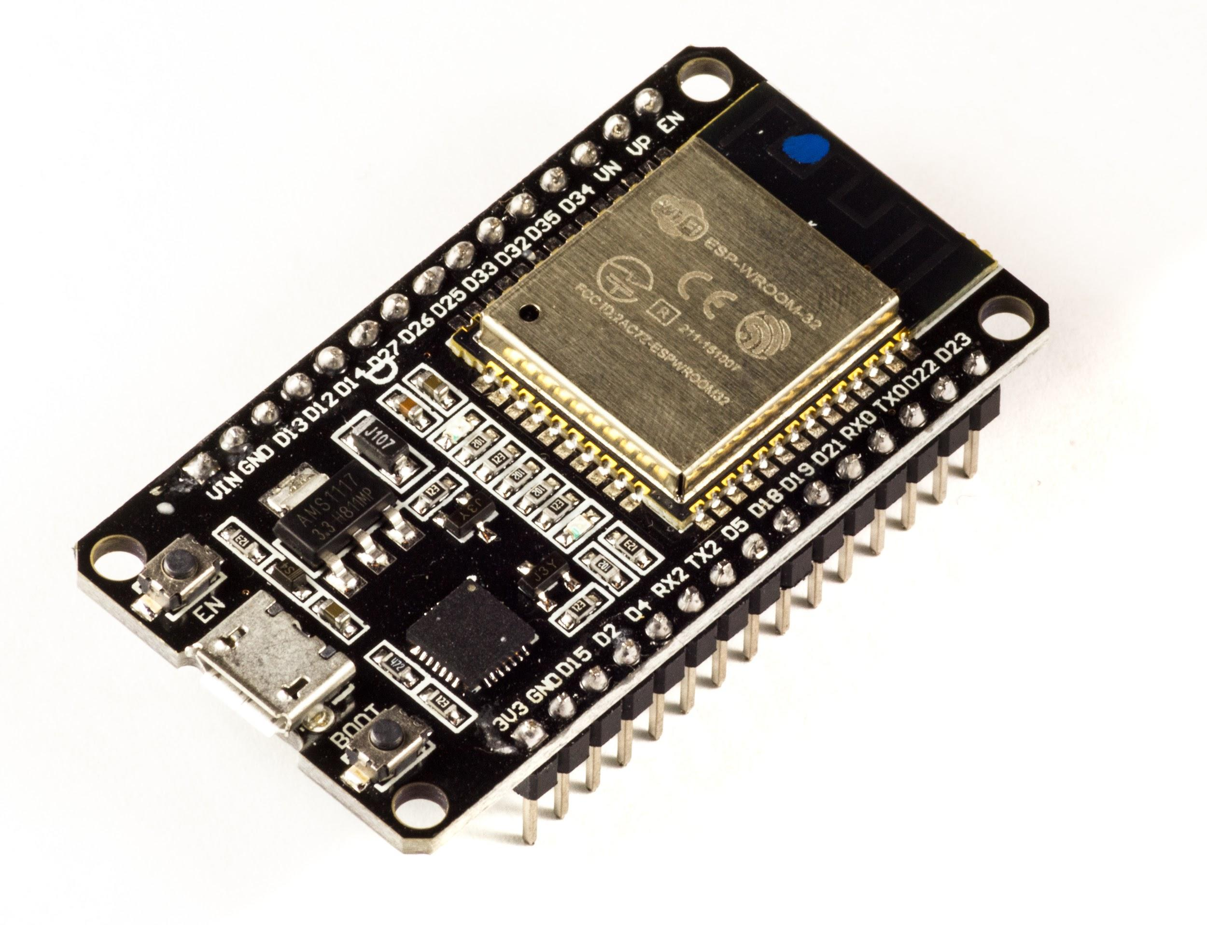
ESP32s - DEVKIT V1 - DOIT
18 ADC Channels
3 SPI interfaces
3 UART interfaces
2 I2C interfaces
16 PWM output channels
2 DAC channels
2 I2S interfaces
10 Capacitive sensing GPIOs

Slide 7
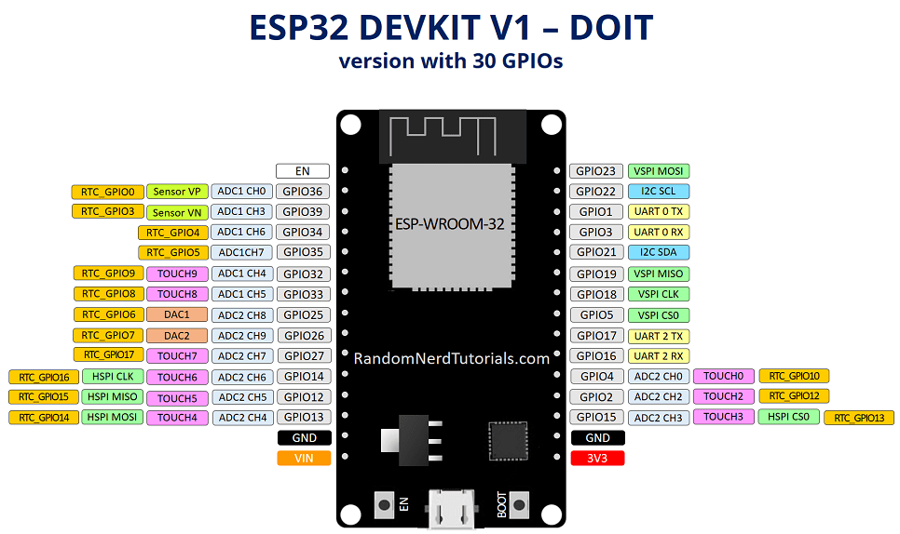
Max. current allowed through a GPIO pin is 40mA.

Slide 8
ADC channels
 | Channels | GPIO
ADC1 | 0 | 36
ADC1 | 1 | 37
ADC1 | 2 | 38
ADC1 | 3 | 39
ADC1 | 4 | 32
ADC1 | 5 | 33
ADC1 | 6 | 34
ADC1 | 7 | 35
ADC2 | 0 | 4
 | Channels | GPIO
ADC2 | 1 | 0
ADC2 | 2 | 2
ADC2 | 3 | 15
ADC2 | 4 | 13
ADC2 | 5 | 12
ADC2 | 6 | 14
ADC2 | 7 | 27
ADC2 | 8 | 25
ADC2 | 9 | 16

Slide 9
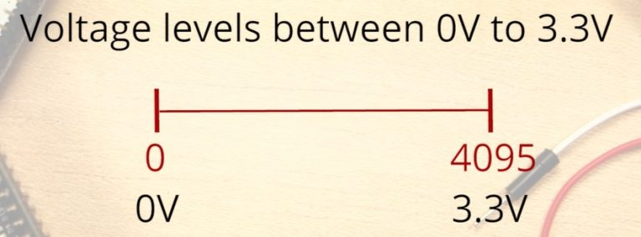
ADC channels
The analog to digital conversion is 12 bit by default.
The voltage measured is then assigned to a value between 0 and 4095, in which 0 V corresponds to 0, and 3.3 V corresponds to 4095.

Slide 10
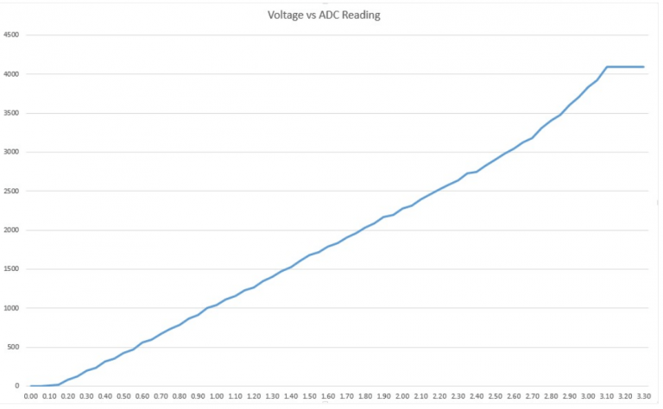
More about ADC channels
This behavior means that your ESP32 is not able to distinguish 3.3 V from 3.2 V. You’ll get the same value for both voltages: 4095.
The same happens for very low voltage values: for 0 V and 0.1 V you’ll get the same value: 0. You need to keep this in mind when using the ESP32 ADC pins.

Slide 11
More about GPIO pins
Input only pins
GPIOs 34 to 39 (4 pins)
SPI flash (not recommended for use)
GPIOs 6 to 11 (6 pins)
DAC
DAC1 - GPIO 25
DAC2 - GPIO 26
PWM
16 independent channels
All pins can be used except for 34 to 39(Input only pins).

Slide 12
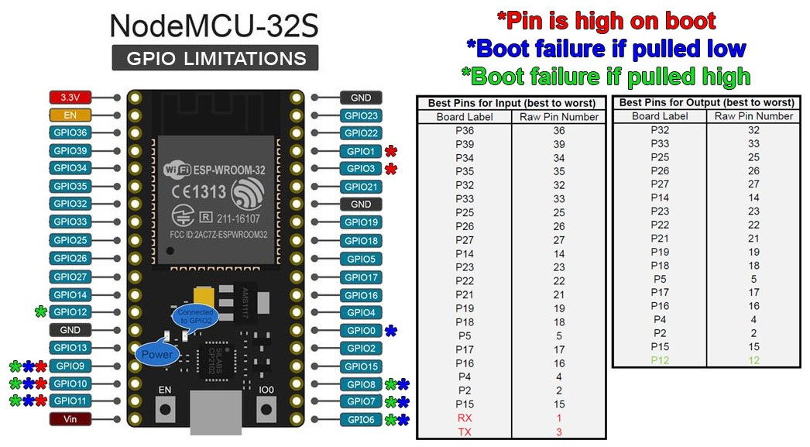

Slide 13
Programming ESP32 with Arduino IDE
https://raw.githubusercontent.com/espressif/arduino-esp32/gh-pages/package_esp32_index.json

Slide 14
Glowing a Led
Why again?
You have seen that we can give signals by glowing a led in any project.
In case of Esp32 we also want to use some medium to show the input we are getting from user.
We can have our user control the led via WiFi which we are restricted by arduino.
This can be used to provide the MCU with any type of input over WiFi and receive any output.

Slide 15
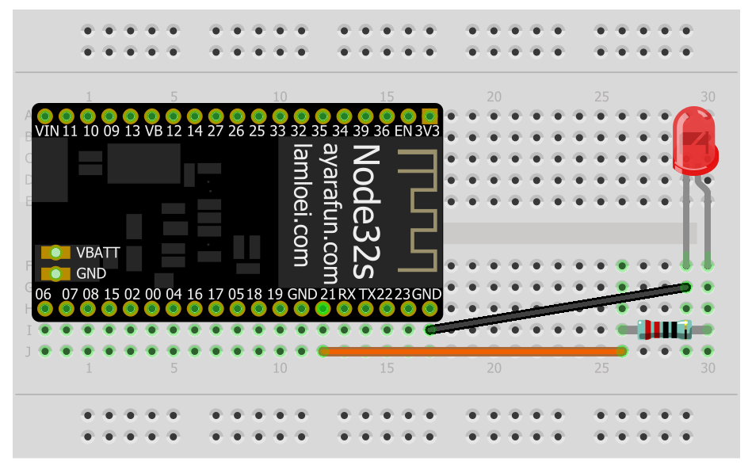

Slide 16
Connecting with WiFi
Why WiFi?
It helps you connect to your system from anywhere in the world.
Inputs can be taken to perform any action from the Internet just like in case of from sensors in the case of arduino.

Slide 17
Generating a WiFi
Why to generate?
By connecting to WiFi you get access to the Internet but what if you want to create a server for your own game.
It helps you to create a local network for transferring files or information over this network .
Via this any user connected to this network can access your system connected to Esp32 via circuits.

Slide 18
Capacitive touch GPIOs
T | GPIO
0 | 4
1 | 0
2 | 2
3 | 15
4 | 13
5 | 12
6 | 14
7 | 27
8 | 33
9 | 32
The ESP32 has 10 internal capacitive touch sensors.
These can sense variations in anything that holds an electrical charge, like the human skin.
These can detect variations induced when touching the GPIOs with a finger.
These pins can be easily integrated into capacitive pads, and replace mechanical buttons.

Slide 20
Other References-
Intro to ESP32
Pinout Reference
ESP32 ADC

Slide 21
Other References-
Codes we used-
Installing Esp32 Library
Links for fetching data from any website -
https://techtutorialsx.com/2017/05/19/esp32-http-get-requests/
https://www.youtube.com/watch?v=66aHd3KMhAk
https://thingspeak.com/
Using Esp32 to make webpage
All Codes used in this session

